Slide 1

Muddy River
Commodities and Real Option Valuation
Oct 10, 2019
Wright Consultancy LLC
485 Madison Ave.
Manhattan, NY 10022
p: +1.212.349.2310
WrightConsultancy

Slide 2


Slide 3

About us
90+ years in management consulting
30k colleagues working in 130 cities
Ranked 1st among consulting firms
in 2019 by Forbes

Slide 4


Meet the Team
Q & A
yakund@andrew.cmu.edu
kaim@andrew.cmu.edu
xiaoqiz@andrew.cmu.edu
xueweiy@Andrew.cmu.edu
Yuxianz@Andrew.cmu.edu

Slide 5
01
Client Specifications

Slide 6


Client Specifications
Client
Counterparty
90% net operating earnings from the Muddy
River Power Plant from 2016-2018
$24m at Dec. 2015
EnerGen Corp.
Bobba Fett
Ultimate Goal Evaluate whether $24M is enough for the real option
1 Client Specifications
2 Solution
3 Underlying Model
4 Sensitivity Analysis
5 Legal Issues

Slide 7
Client Specifications
Muddy River Power Plant
- Generation Capacity: 1000 megawatts
- Heat rate: 12 mmBTU/Mwh
- Non-fuel variable costs: $5 per Mwh megawatts
- Status now: Off
Client
EnerGen Corp.
[ Two Constraints ]
Start Week Cost
($3/Mwh)
End Week Lag
01
02
1 Client Specifications
2 Solution
3 Underlying Model
4 Sensitivity Analysis
5 Legal Issues

Slide 8
02
Valuation Solution

Slide 9
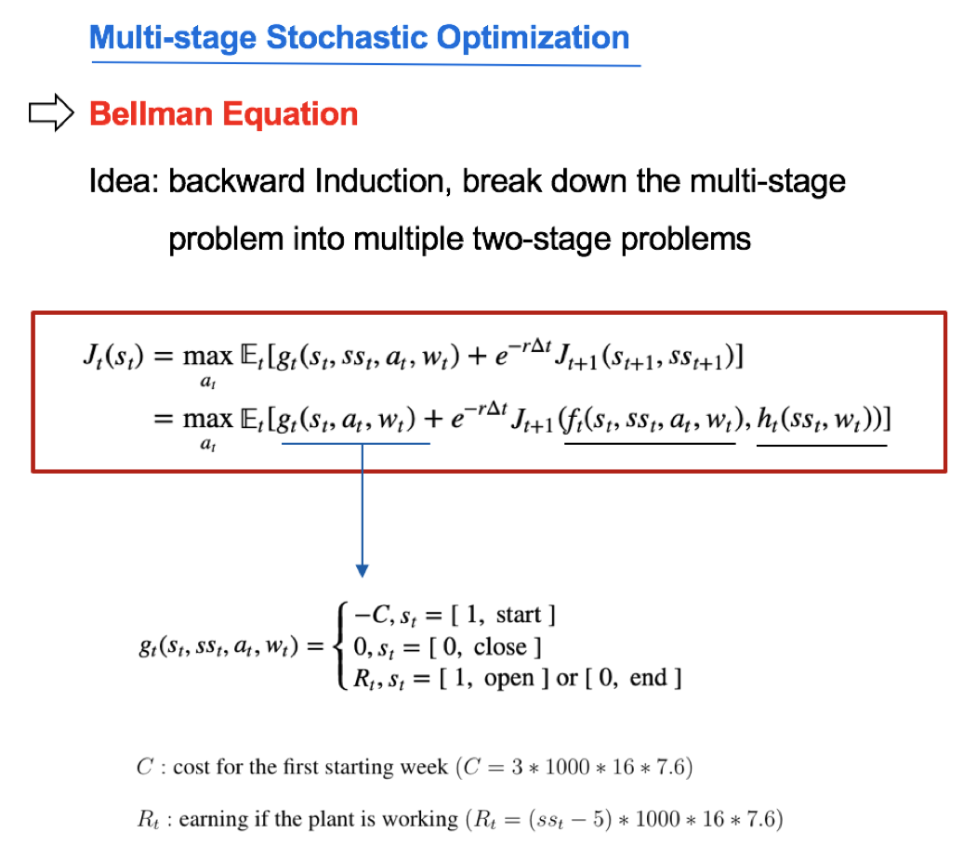

Operation Strategy and Profit

Slide 10
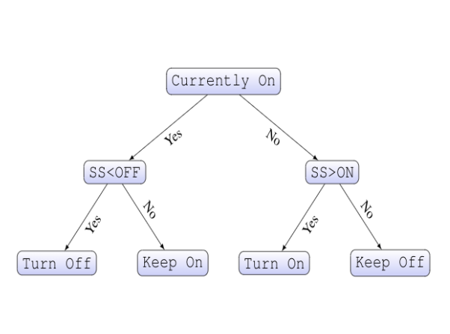
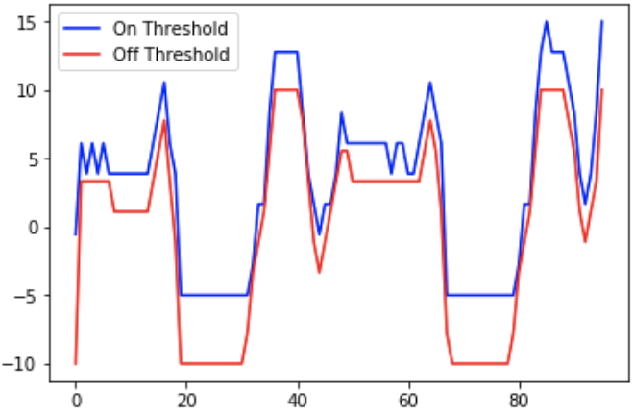
Valuation Solution
Sustainable Operating Policy
- Strategy Duration : 3 years
- Net Earning Calculation: 2 years
SS: spark spread (Power– 12 * Gas)
1 Client Objective
2 Solution
3 Model Construction
4 Valuation Strategy
5 Sensitivity Analysis

Slide 11
Valuation Solution
Sustainable Operating Policy
Valuation Result
- Strategy Duration : 3 years
- Net Earning Calculation: 2 years
90% of the net operating policy:
$93.98m
1 Client Objective
2 Solution
3 Model Construction
4 Valuation Strategy
5 Sensitivity Analysis

Slide 12
03
Underlying Model

Slide 13
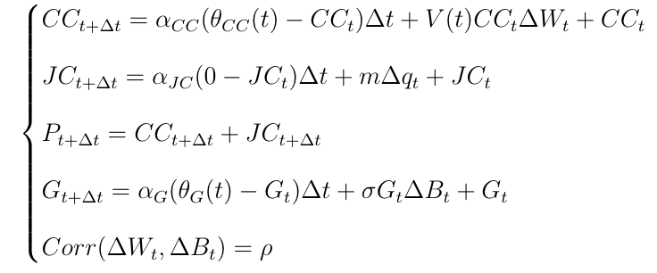
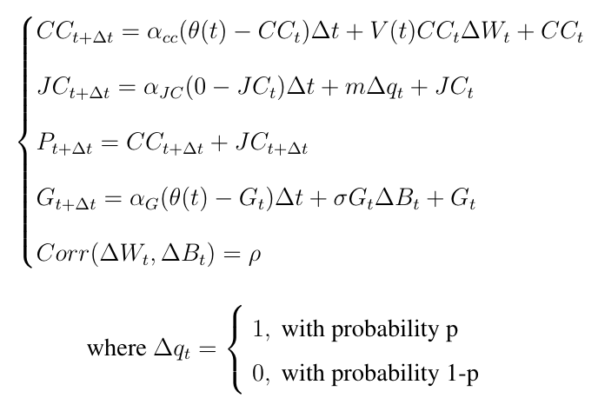
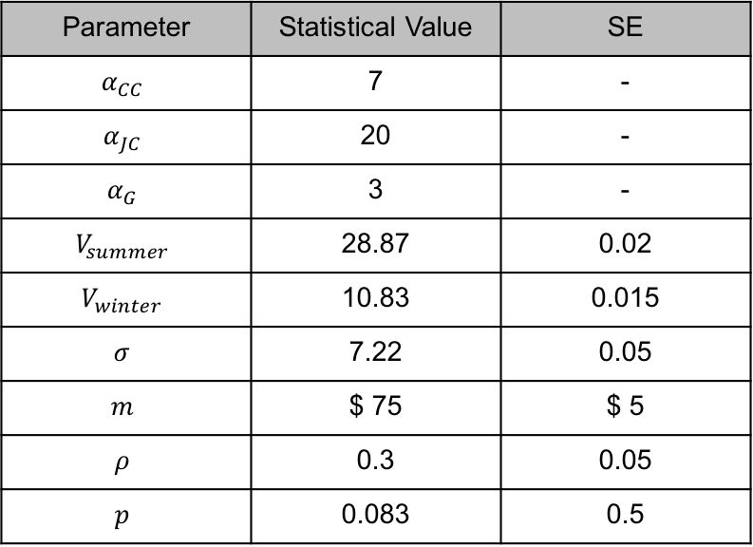
Model Calibration
Power and Gas Process
Parameter | Statistical Value | SE
$$α_{CC}$$ | 7 | -
$$α_{JC}$$ | 20 | -
$$α_{G}$$ | 3 | -
$$V_{summer}$$ | 28.87 | 0.02
$$V_{winter}$$ | 10.83 | 0.015
$$σ$$ | 7.22 | 0.05
$$m$$ | $ 75 | $ 5
$$ρ$$ | 0.3 | 0.05
$$p$$ | 0.083 | 0.5
* The values of $V_{summer}$/ $V_{winter}$/ $σ$/ $prob(Δq_{t}=1)$ are un-annualized
1 Client Objective
2 Solution
3 Model Construction
4 Valuation Strategy
5 Sensitivity Analysis

Slide 14
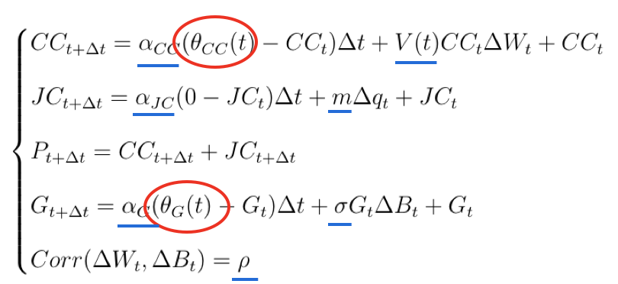
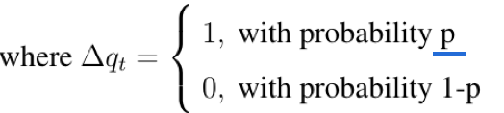

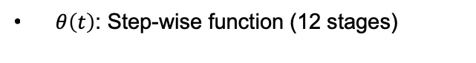
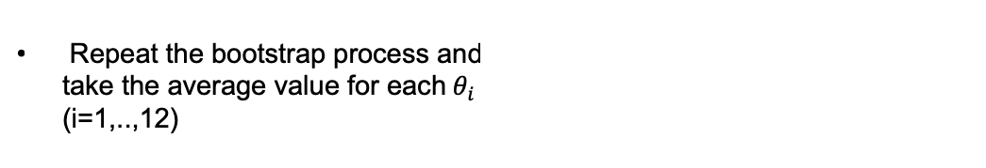
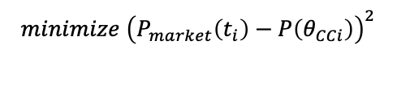
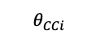
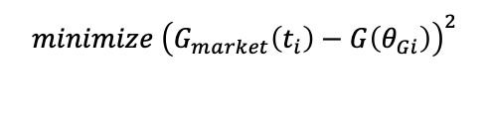

Model Calibration
Power and Gas Process
$θ\left(t\right)$ Calibration
$θ\left(t\right)$: Step-wise function (12 stages)
BootStrap calibration to match the
corresponding forward prices
$$minimize {\left(P_{market}\left(t_{i}\right)−P\left(θ_{CCi}\right)\right)}^{2}$$
$$θ_{CCi}$$
$$minimize {\left(G_{market}\left(t_{i}\right)−G\left(θ_{Gi}\right)\right)}^{2}$$
$$θ_{Gi}$$
Repeat the bootstrap process and
take the average value for each${ θ}_{i }$
(i=1,..,12)
1 Client Objective
2 Solution
3 Model Construction
4 Valuation Strategy
5 Sensitivity Analysis

Slide 15
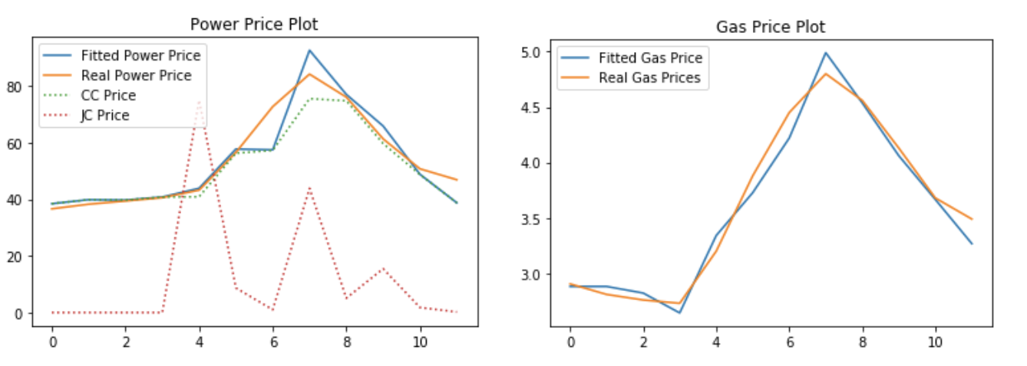
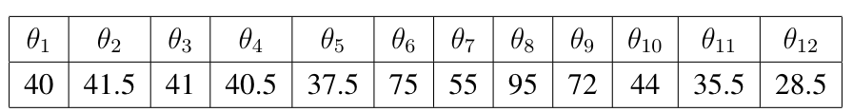
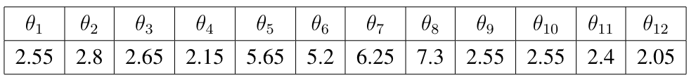



Model Calibration
$θ\left(t\right)$ Calibration
Calibration Result
$$Power$$
$$Gas$$
1 Client Objective
2 Solution
3 Model Construction
4 Valuation Strategy
5 Sensitivity Analysis

Slide 16
04
Sensitivity Analysis

Slide 17
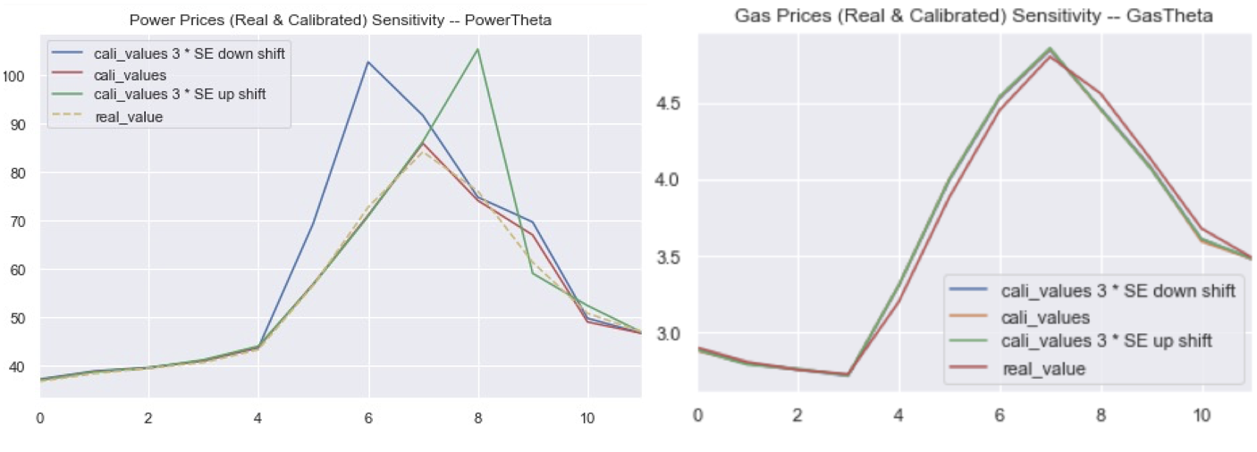

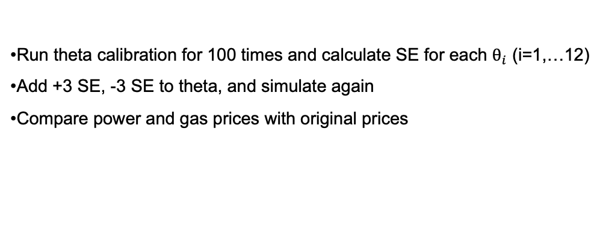

Model Sensitivity
comparison with original forward curves
$θ\left(t\right)$ Calibration
Run theta calibration for 100 times and calculate SE for each $θ_{i}$ (i=1,…12)
Add +3 SE, -3 SE to theta, and simulate again
Compare power and gas prices with original prices
Sensitivity Analysis on $θ(t)$
1 Client Objective
2 Solution
3 Model Construction
4 Valuation Strategy
5 Sensitivity Analysis

Slide 18
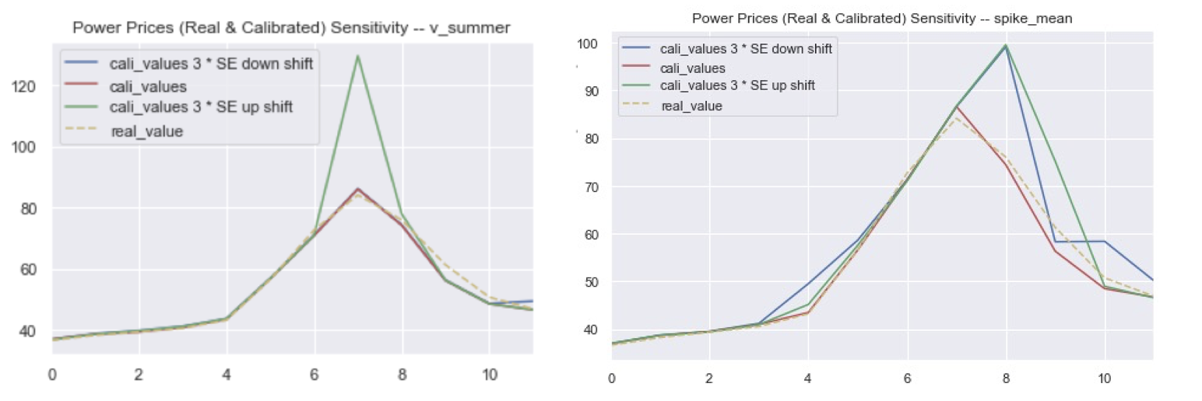
Model Sensitivity
comparison with original forward curves
$θ\left(t\right)$ Calibration
Sensitivity Analysis on other parameters
1 Client Objective
2 Solution
3 Model Construction
4 Valuation Strategy
5 Sensitivity Analysis

Slide 19
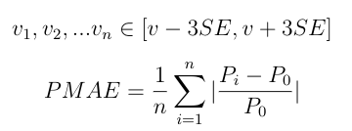
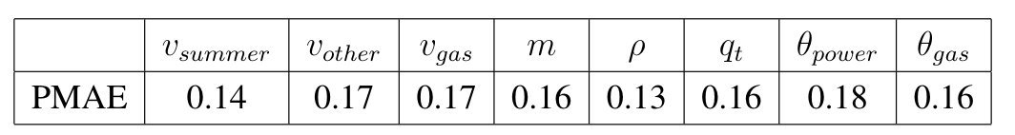
Valuation Sensitivity
Influence of different parameters changes on the final valuation for earnings
Percentage Mean Absolute Deviation
1 Client Objective
2 Solution
3 Model Construction
4 Valuation Strategy
5 Sensitivity Analysis

Slide 20
05
Legal Issues

Slide 21

Legal Issues
Legal consulting team
led by Alicia Florrick
Key drivers of our valuation strategy
Stable Calibration Parameters
Operable and Effective Policy
Model and Valuation Sensitivity Analysis
Valuation Result (Sustainable strategy)
90% x $104.42M = $93.98>> $24M
$24M is far from enough for the real option.
Conclusion

Slide 22
Q&A
Q & A

Slide 23
06
Appendix

Slide 24
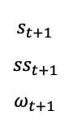

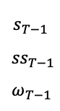
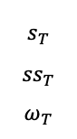

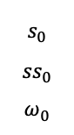


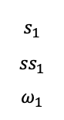

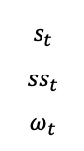
Valuation Strategy
Operating Policy based on Dynamic Threshold
Some Notation
$θ\left(t\right)$ for Power
$$K_{t}^{on}$$
$$K_{t}^{off}$$
$$a_{t}$$
$$K_{T−1}^{on}$$
$$K_{T−1}^{off}$$
$$a_{T−1}$$
$K_{t}^{on}$/ $K_{t}^{off}$: On and off threshold at stage t
$a_{t}$: action at stage t.
$$a_{t}∈\left\{open, close\right\}$$
$s_{t}$: state of the power plant at stage t
$$s_{t}∈\{\left[1, open\right], \left[0, close\right], \left[1,start\right], [0,end]\}$$
${ss}_{t}$: spark spread at stage t
$${ss}_{t}=P_{t}−12∗G_{t}$$
$ω_{t}$: represent random disturbance between t and t+1
$$K_{0}^{on}$$
$$K_{0}^{off}$$
$$a_{0}$$
$$K_{1}^{on}$$
$$K_{1}^{off}$$
$$a_{1}$$
Action
…
…
…
…
0
1
t-1
t
t+1
T-1
T
$$s_{0}$$
$${ss}_{0}$$
$$ω_{0}$$
$$s_{1}$$
$${ss}_{1}$$
$$ω_{1}$$
$$s_{t}$$
$${ss}_{t}$$
$$ω_{t}$$
$$s_{t+1}$$
$${ss}_{t+1}$$
$$ω_{t+1}$$
$$s_{T−1}$$
$${ss}_{T−1}$$
$$ω_{T−1}$$
$$s_{T}$$
$${ss}_{T}$$
$$ω_{T}$$
State
…
1 Client Objective
2 Solution
3 Model Construction
4 Valuation Strategy
5 Sensitivity Analysis

Slide 25
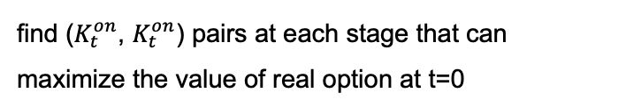
Valuation Strategy
Operating Policy based on Dynamic Threshold
$θ\left(t\right)$ Calibration
Goal
$$K_{T−1}^{on}$$
$$K_{T−1}^{off}$$
$$a_{T−1}$$
find ($K_{t}^{on}$, $K_{t}^{on}$) pairs at each stage that can
maximize the value of real option at t=0
$θ\left(t\right)$ for Power
$$K_{t}^{on}$$
$$K_{t}^{off}$$
$$a_{t}$$
$$K_{0}^{on}$$
$$K_{0}^{off}$$
$$a_{0}$$
$$K_{1}^{on}$$
$$K_{1}^{off}$$
$$a_{1}$$
Action
…
…
…
…
0
1
t-1
t
t+1
T-1
T
$$s_{0}$$
$${ss}_{0}$$
$$ω_{0}$$
$$s_{1}$$
$${ss}_{1}$$
$$ω_{1}$$
$$s_{t}$$
$${ss}_{t}$$
$$ω_{t}$$
$$s_{t+1}$$
$${ss}_{t+1}$$
$$ω_{t+1}$$
$$s_{T−1}$$
$${ss}_{T−1}$$
$$ω_{T−1}$$
$$s_{T}$$
$${ss}_{T}$$
$$ω_{T}$$
State
…
Multi-stage Stochastic Optimization
1 Client Objective
2 Solution
3 Model Construction
4 Valuation Strategy
5 Sensitivity Analysis

Slide 26
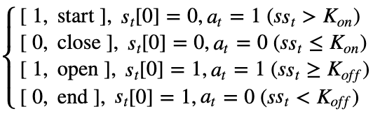
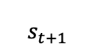
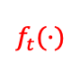
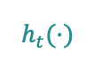

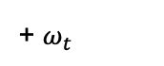
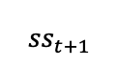
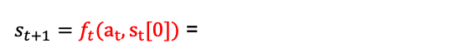
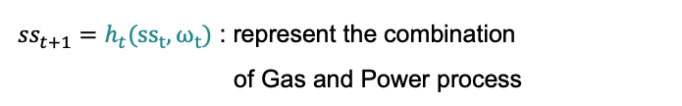

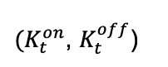
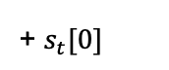
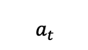
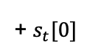
Valuation Strategy
Operating Policy based on Dynamic Threshold
System Dynamics
$θ\left(t\right)$ Calibration
At stage t, ($s_{t}$, ${ss}_{t}$) known
$θ\left(t\right)$ for Power
$$K_{t}^{on}$$
$$K_{t}^{off}$$
$$a_{t}$$
$$K_{T−1}^{on}$$
$$K_{T−1}^{off}$$
$$a_{T−1}$$
$(K_{t}^{on}$, $K_{t}^{off}$)
$$K_{0}^{on}$$
$$K_{0}^{off}$$
$$a_{0}$$
$$K_{1}^{on}$$
$$K_{1}^{off}$$
$$a_{1}$$
Action
…
…
$${ss}_{t}$$
+ $s_{t}[0]$
$$h_{t}(·)$$
+ $ω_{t}$
$$a_{t}$$
…
…
$${ss}_{t+1}$$
0
1
t-1
t
t+1
T-1
T
$$f_{t}(·)$$
+ $s_{t}[0]$
$$s_{0}$$
$${ss}_{0}$$
$$ω_{0}$$
$$s_{1}$$
$${ss}_{1}$$
$$ω_{1}$$
$$s_{t}$$
$${ss}_{t}$$
$$ω_{t}$$
$$s_{t+1}$$
$${ss}_{t+1}$$
$$ω_{t+1}$$
$$s_{T−1}$$
$${ss}_{T−1}$$
$$ω_{T−1}$$
$$s_{T}$$
$${ss}_{T}$$
$$ω_{T}$$
$$s_{t+1}$$
State
…
$s_{t+1}=f_{t}(a_{t}, s_{t}[0])$ =
Law of Motion
${ss}_{t+1}=h_{t}({ss}_{t}, ω_{t})$ : represent the combination
of Gas and Power process
1 Client Objective
2 Solution
3 Model Construction
4 Valuation Strategy
5 Sensitivity Analysis

Slide 27
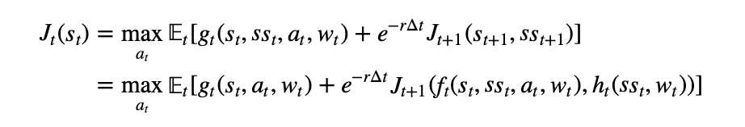
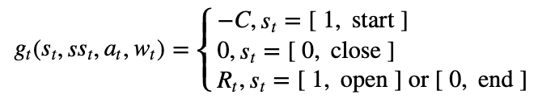
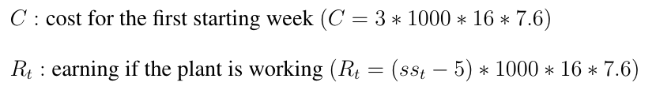
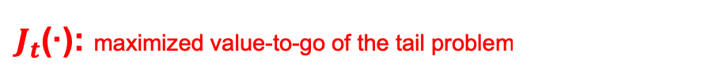

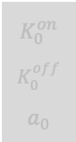

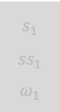
Valuation Strategy
Operating Policy based on Dynamic Threshold
Multi-stage Stochastic Optimization
$θ\left(t\right)$ Calibration
Bellman Equation
$$K_{T−1}^{on}$$
$$K_{T−1}^{off}$$
$$a_{T−1}$$
Idea: backward Induction, break down the multi-stage
problem into multiple two-stage problems
$θ\left(t\right)$ for Power
$$K_{t}^{on}$$
$$K_{t}^{off}$$
$$a_{t}$$
$$K_{0}^{on}$$
$$K_{0}^{off}$$
$$a_{0}$$
$$K_{1}^{on}$$
$$K_{1}^{off}$$
$$a_{1}$$
Action
…
…
…
…
0
1
t-1
t
t+1
T-1
T
$$s_{0}$$
$${ss}_{0}$$
$$ω_{0}$$
$$s_{1}$$
$${ss}_{1}$$
$$ω_{1}$$
$$s_{t}$$
$${ss}_{t}$$
$$ω_{t}$$
$$s_{t+1}$$
$${ss}_{t+1}$$
$$ω_{t+1}$$
$$s_{T−1}$$
$${ss}_{T−1}$$
$$ω_{T−1}$$
$$s_{T}$$
$${ss}_{T}$$
$$ω_{T}$$
State
…
$J_{t}$(·): maximized value-to-go of the tail problem
1 Client Objective
2 Solution
3 Model Construction
4 Valuation Strategy
5 Sensitivity Analysis

Slide 28
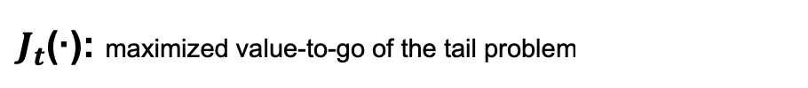
Valuation Strategy
Operating Policy based on Dynamic Threshold
Multi-stage Stochastic Optimization
$θ\left(t\right)$ Calibration
Bellman Equation
$$K_{T−1}^{on}$$
$$K_{T−1}^{off}$$
$$a_{T−1}$$
Idea: backward Induction, break down the multi-stage
problem into multiple two-stage problems
$θ\left(t\right)$ for Power
$$K_{t}^{on}$$
$$K_{t}^{off}$$
$$a_{t}$$
$$K_{0}^{on}$$
$$K_{0}^{off}$$
$$a_{0}$$
$$K_{1}^{on}$$
$$K_{1}^{off}$$
$$a_{1}$$
Action
…
…
…
…
0
1
t-1
t
t+1
T-1
T
$$s_{0}$$
$${ss}_{0}$$
$$ω_{0}$$
$$s_{1}$$
$${ss}_{1}$$
$$ω_{1}$$
$$s_{t}$$
$${ss}_{t}$$
$$ω_{t}$$
$$s_{t+1}$$
$${ss}_{t+1}$$
$$ω_{t+1}$$
$$s_{T−1}$$
$${ss}_{T−1}$$
$$ω_{T−1}$$
$$s_{T}$$
$${ss}_{T}$$
$$ω_{T}$$
State
…
Longstaff and Schwartz
$J_{t}$(·): maximized value-to-go of the tail problem
1 Client Objective
2 Solution
3 Model Construction
4 Valuation Strategy
5 Sensitivity Analysis

